Slide 1
Testing strategy to ensure the quality of HIV diagnosis
CDC RT-CQI Workshop – Western Hemisphere
Session 1.4
Panama City, Panama
August 26, 2024
Dr Alaleh Abadpour, WHO
Emanny Sanchez, CDC-Atlanta, HIV Testing Services Team

Slide 2
HIV Testing Services Guiding Principles
Consensual
Confidential
Counseling
Correct test results
Connection to services
Notes:
In the landscape of HIV Testing Services, WHO advices that all HIV Testing Services be implemented in accordance with the 5 Cs, that is :
that services must be Consensual, Confidential, that clients are provided with pre-test information and post-test Counselling, that clients are provide Correct results and that they are Connect to appropriate prevention and treatment services.
With respect to correct test results, this denotes the need to provide high-quality testing services by service providers, as well as establish quality assurance mechanisms to ensure that people receive a correct diagnosis. And quality assurance may include both internal and external measures and should include support from the national reference laboratory.
Thus, quality is inherently part of our programmatic principles.

Slide 3
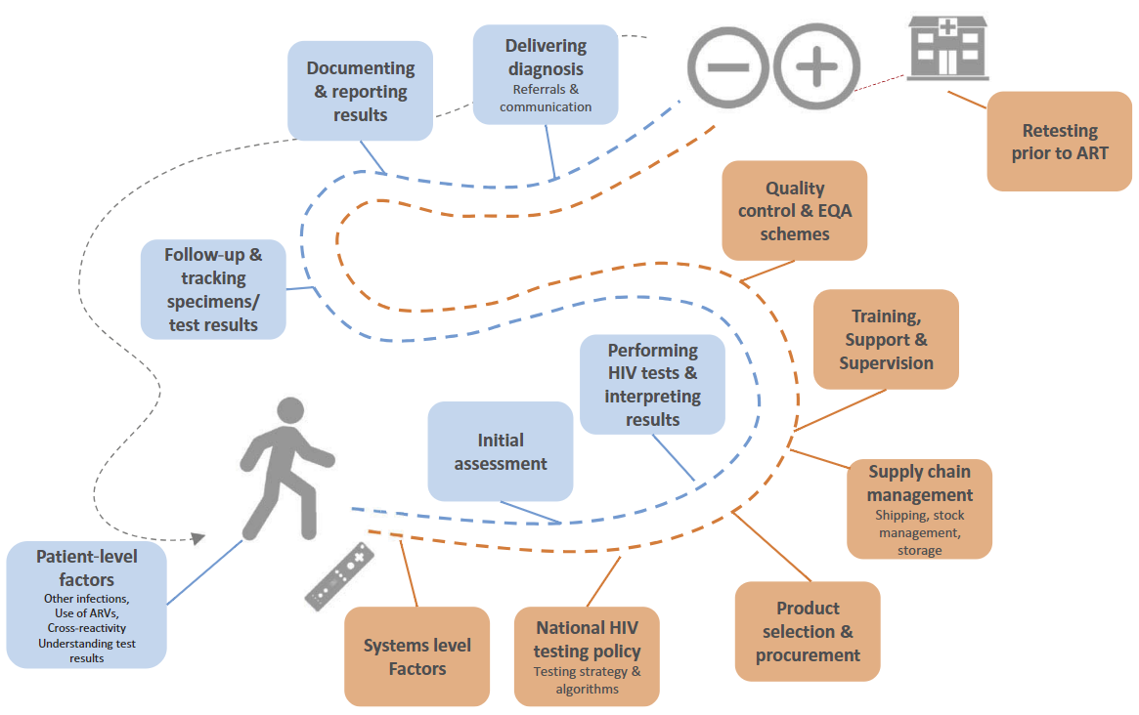
Role of HIV Testing Continuum on Quality
Steps along the HIV testing continuum that can influence overall quality
Johnson CC et al. Journal of the International AIDS Society 2017, 20(Suppl 6):22190
Notes:
This is an illustration of the testing continuum. As we will continue to explore over the next five days, there are several places where diagnostic errors and therefore a reduction of testing quality can occur on the HIV testing continuum. There are likely misdiagnoses occurring within HIV programming with a number of root causes stemming from different points along the HIV testing continuum, whether at the facility where the test kits are being manufactures, how they are transported and stored, to the trainings provided to the health providers, quality assurance systems.
There is no individual aspect that impact quality of test results, rather there are many steps along the continuum that can impact correct test results; we need to think about all these steps to ensure quality testing and ensure correct test results.
We know that misdiagnosis have substantial impact and implications on individuals and health systems, and that efforts to course correct by "undiagnosing" persons on ART can be difficult and expensive. While rates of misdiagnoses are still not well quantified, we know that development and adherence to a verified testing algorithm within a National testing strategy is the key starting point to ensuring HIV testing provides accurate diagnoses.
As my co presenter introduced, the rest of this session will focus on implementation of a National HIV Testing strategy & algorithm within our programs.

Slide 4
PEPFAR Guidance
FY24 Technical Considerations
Misdiagnosis of HIV status can occur due to poor quality HIV tests, limitations of the national testing algorithm or the testing process
Development and adherence to a National testing algorithm as a key element of HIV RTCQI
PEPFAR supported sites should retest all newly identified HIV-positive persons before initiation of ART
  A quality assurance measure to reduce HIV misdiagnosis
  Should occur prior to/at ART initiation
  Only apply to newly identified PLHIV not yet initiated on ART
  Retesting is cost effective in several populations (Hsiao et al. 2017, Eaton et al. 2017, Lasry et al. 2019)
Notes:
There are a lot of steps along that continuum where things can happen that affect the quality of testing or a correct test results.
In alignment with WHO, PEPFAR supports the adoption of testing strategies that include a verified National HIV Rapid Testing algorithm and the implementation of retest for verification prior to ART initiation as two key elements in ensuring HIV diagnostic quality.
PEPFAR FY24 technical considerations highlight the importance of the development and adherence to an evaluated national testing algorithm to ensure accurate diagnoses and is a key element in ensuring diagnostic quality.
Retest for verification of all newly identified HIV positive persons before initiation on ART is recommended for all PEPFAR supported sites, again this is highlighted as an important quality assurance measure to reduce HIV misdiagnosis, should only be performed on newly identified PLHIV not yet initiated on ART. And retesting for verification has been shown to be cost effective

Slide 5
PEPFAR Supported Countries – 2 vs 3 test algorithm
Two Test
Three Test
Transition underway
5
PEPFAR Supported Countries
*25
PEPFAR Supported Countries
7
PEPFAR Supported Countries
*7
Use a 3rd RDT as tie breaker
**6
Use ELISA as T2 or T3
N=41 country HTS programs
(2 countries excluded)
Notes:
As it pertains to testing algorithms, this slides is meant to meant to give a picture of where some of the countries PEPFAR supports are in relation to a shift to a 3-test strategy.
Per WHO’s 2019 recommendations, many PEPFAR supported countries have already transitioned or are planning a transition from a two to a three-test algorithm for HIV diagnosis.
Based of our current records of countries the CDC HQ HTS team supports, there are 25 currently implementing a 2-test strategy. Of these, 5 are actively transitioning to a serial three test strategy, while 7 are currently implementing a serial three test strategy. 7 countries use a 3rd rapid diagnostic test as a tie breaker, and **6 use ELISA as T2 and/or T3, even though this is no longer recommended.
*************
The countries using ELISA as part of their diagnostic algorithm were not included in the 2 or 3 test totals
For some Asian countries, they could use a rapid test or an elisa test. Any algorithm that use an elisa as 2n or 3rd test are set aside as this is not what we mean when we say verified/ approved or recommended method of testing.

Slide 6
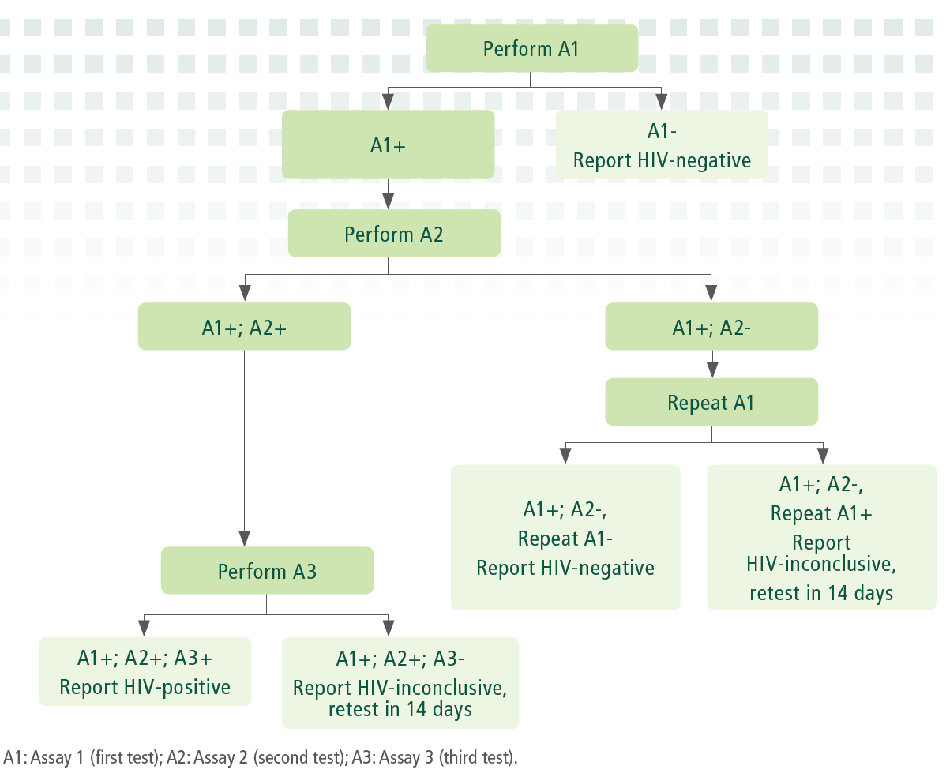
Tiebreaker strategy
Tiebreaker strategy – use of a third test for diagnosis in cases of discrepant results between T1 and T2 tests
Numerous studies have shown that using a tiebreaker to rule in HIV infection led to increased risk of false-positive results and misdiagnosis (Johnson CC et al, 2017)
  One study in Uganda found 95% of all false positive results were due to use of tiebreaker testing (Grey RH et al, 2007)
For 3 test algorithm - in event of discordance between T1 & T2, repeat T1
  Repeat T1 is negative, report as HIV negative
  Repeat T1 is positive, report as inconclusive
Johnson CC et al. Journal of the International AIDS Society 2017; Grey R.H et al, BMJ, 2007.
Notes:
As we saw in the previous slides, some countries are not aligned with international recommendations whereby there are implementing a tiebreaker strategy, that is, using a 3rd test for diagnosis in the case of a discrepant results between T1 and T2, and though they are technically implementing a 3-test strategy, they are not implementing it correctly.
Studies have shown that tiebreaker testing strategies increase the likelihood of false-positive results (WHO Information note, Preventing HIV misdiagnosis, Dec 2023), one study in Uganda found that 95% of all false positive results were due to the use of tiebreaker testing, thus this is not recommended by WHO or PEPFAR.
In a 3-test algorithm, In the event of discordance between T1 and T2, repeat T1. If repeat T1 is negative, report as HIV neg. If repeat T1 is positive, report as inconclusive.
So again, highlighting the importance of implementing and evaluated and verified National HIV Rapid Testing algorithm to ensure the quality of HIV diagnosis.

Slide 7
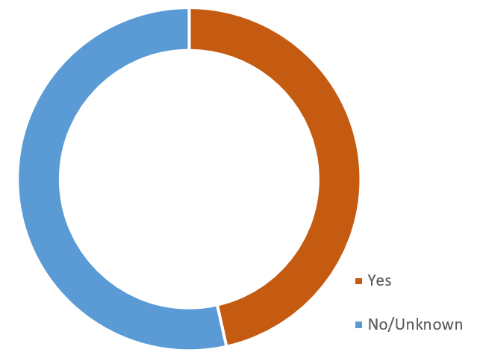
PEPFAR Supported Countries – Retest for Verification
Proportion implementing retest for verification prior to ART initiation
23
20
Notes:
Retest for verification is an essential quality assurance measure that works to ensure we are providing the correct diagnosis for clients. This is the case regardless of what testing strategy is in use by a program. Based on my teams most recent HTS landscape analysis, 20 of 43 CDC supported HTS country programs are currently implementing retest for verification prior to ART initiation. The remaining 23 for either not implementing or our data may be outdated; we are actively collecting this information and updating this data.
Please note that this is global data and we do not have the specific for the region. But we can see, of that data that we have pertaining to CDC supported countries, almost half are implementing test for verification.

Slide 8
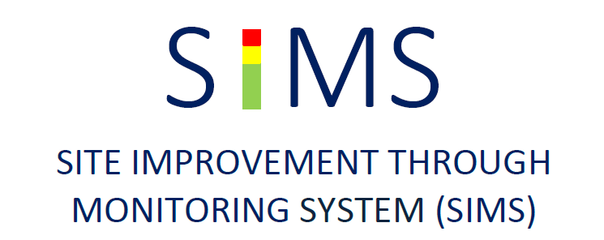
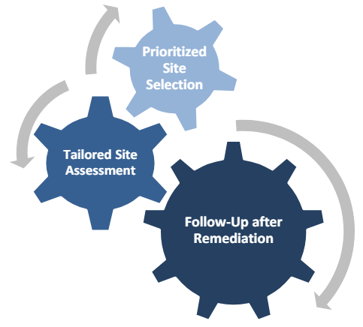
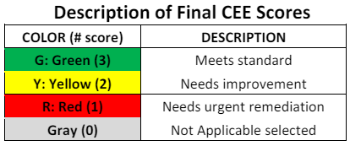
SIMS
Standardized QA approach to monitor impact of PEPFAR programs by assessing site performance against defined quality standards & identifies areas in need of improvement
Ten sets of core essential elements (CEEs) for a program to select based on what is relevant to their minimum program requirements & program areas
From FY19-FY24, the cumulative number of comprehensive or concentrated SIMS assessments conducted across all 18 CDC/PEPFAR supported SSA countries was 3,154.
Notes:
One of the many ways we assess quality of testing services among PEPFARs supported sites is through SIMS.
SIMS is a PEPFAR acronym that stands for Site Improvement through Monitoring Systems. SIMS takes a standardized quality assurance approach to monitor impact of PEPFAR programs by assessing site performance against PEPFAR accepted quality standards and identifies areas where quality improvement is needed.
SIMS assessment consists of 10 recommended sets of what we call core essential elements (CEEs), , a program select which CEEs are relevant to their minimum program requirements and their IP-supported program areas at each site/health facility. Following the assessment,
SIMS scores are given by CEE at the site level where green means the site meets the defined standards, yellow means site needs improvement and red means the site needs urgent remediation.

Slide 9
SIMS HTS Quality Definitions
S_07_01 Compliance with National Testing Algorithm and Strategy
  Does the site have written or printed testing protocols or other job aides that are in full accordance with the current national testing algorithm?
  Is the site collecting the following information in either an HTS register, rapid testing logbook or some other data collection tool?
    Test 1, Test 2, Test 3 (if applicable), final result
  What percentage of the 20 most recent entries within the past 12 months are compliant with the national testing algorithm?
S_07_02 QA of HTS
  Does the manager or laboratorian observe and document each HTS provider conducting HIV rapid testing at least twice a year?
  Does the manager or laboratorian at the HTS site review the logbook/HTS register at least monthly for evidence of compliance with national testing algorithm?
  In the HTS register/logbook, is there a process in place to review QA variables (e.g. positive concordance rate b/w T1 & T2, number of invalid test results, etc) at least quarterly?
S_02_01 Retesting for verification before/at ART initiation (Gen Pop)
  Do the national HIV Testing Services (HTS) or ART guidelines include retesting for verification prior to or at ART initiation?
  Is a standardized process available for conducting and documenting retesting for verification prior to or at ART initiation?
  What percent of adult and adolescent client records reviewed have documentation that retesting for verification occurred before ART initiation? (i.e., the site knows the client or client was retested for verification before/at ART initiation)
Notes:
Within the SIMS assessments, there are a few Core Essential Elements specifically focused on assessing the quality of HIV Testing services, specifically, on assessing compliance with national algorithms, quality assurance of HIV testing services, and assessing for retesting for verification before ART initiation. And each of these CEES are comprise of these questions and components.

Slide 10
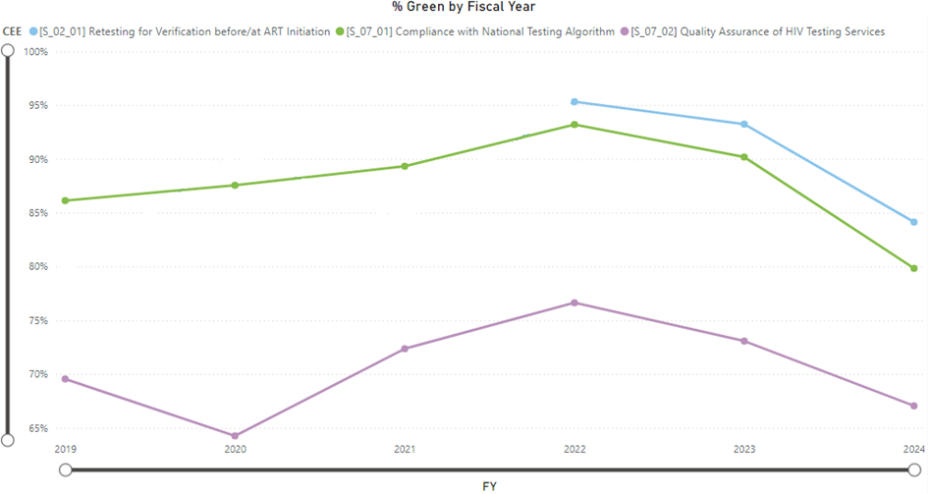
PEPFAR SIMS data for HTS Quality Core Essential Elements
Gen Pop retesting for verification prior to ART initiation
Compliance with National Testing Algorithm
Quality Assurance of HTS
Note: CEE S_02_01 data from 2019-2022 is not available due to changes in the CEE beginning in FY22.
Data Source: CDC Strategic Data Management System (sDMS) Power BI Dashboard
Notes:
This chart here is showing global data for three HTS Quality CEEs: Retest for verification prior to ART initiation for adults in blue, compliance with national testing algorithm in green, and quality assurance of HIV Testing Services in purple.
These data displayed are the percent of sites scoring green in all assessments of that CEE performed in CDC supported countries since FY19. The proportion of green scores has been declining since 2022, with quality assurance of HTS scoring green the least amongst sites. This decline is of note and is a good thing to look at on the country level.

Slide 11
Barriers to High Quality Testing Strategy Implementation
Strategy not based on WHO recommendation
Logistical challenges
Stock outs and/or shelf life of one or more RTKs
Decreased kit quality through storage or expiry
Training & supportive supervision gaps
Lack of comprehensive QA procedures
Patient volume/facility constraints
No SOP available for tester reference
No alternative algorithm identified
Misinterpretation of faint line results
Retesters on ART
Notes:
Here I am sharing some known and observed barriers to implementing a high quality testing strategy with fidelity.
Alelah just presented on WHOs recommendations for implementing an HIV testing strategy and their importance for ensuring quality. We would like to emphasize the importance of conducting an appropriate verification exercise for a National HIV Testing algorithm including any changes that need to be made. This ties into the importance of having an alternative algorithm to default to in case of logistical challenges with supply, distribution or lot quality.
Poor training and supportive supervision of testers that can lead to test procedures not being followed/adhered to correctly.
No SOPs available for testers to refer to when needed
Lack of comprehensive QA procedures in place that inform questionable performance and/or practices (i.e. standardized logbooks, PT, etc.)
As well as re-testers on ART. While PEPFAR does not recommend retesting those previously diagnosed and initiated on treatment, there are many reasons why PLHIV may retest. Retesters currently on ART pose a unique and often rare situation where they cannot be accurately identified by rapid tests
Understanding these barriers then allows us to identifying strategies to address them

Slide 12
Retesters/Reengagers
ART has been found to potentially impact the sensitivity of HIV RDTs causing false-negative test results¹⁻⁵
False-negative test results could lead to confusing results, stopping of ART and investment in expensive strategies to identify and resolve cases
Data suggests that PLHIV on ART are retesting (~25-50%)⁶⁻⁸
  Given the significant number of individuals on ART and more starting everyday this may be a growing issue to consider.
As we think about diagnostics and quality (correct test results), we need to also think about impact of false-negatives and balance clinical utility and quality of testing.
  Are there strategies to avoid unnecessarily retesting of individuals on ART on the program side?
  Are there test kits and strategies that may be more affected that should be considered when developing testing algorithm?
  Are there research gaps or innovations that should be considered?
Source: 1. Johnson et al 2017; 2. Bock et al 2017; 3. Olaru et al 2017; 4. Fogel et al 2017; 5. Fogel et al 2015; 6. Kumwenda et al 2014; 7. Moore et al 2017; 8. Mavedezenge et al 2015
Notes:
Data suggests that PLHIV on ART are retesting, contributing to approximately 25-50% of total tests. It is well known that it is possible for ART use to impact the sensitivity of HIV rapid diagnostic test kits, resulting to false-negative test results, leading to confusing results, stopping ART and investment in expensive strategies to identify and resolve cases. Given the number of individuals on ART, a cohort that is growing every day, this may be a growing issue that programs need to consider. We can think about the diagnostic and quality, we also need to think about the impact of false-negatives on quality of diagnostics and balance it with clinical utility. Some questions we can ask ourselves are...(read from slide).
Q1- using unique identifier, implementing and having EMR systems, being able to support individual who transfer, and individuals falling out of care and ensuring that they do not fall out of care, ensuring clients are properly linked after an initial positive Dx, proper education on ART and on U=U and what this mean.
Q2- are there test kits or strategies that are more vulnerable to these individuals?
There are just some questions to stimulate thoughts and ideas.
**********************************************
Barrier to quality because of the sero conversion, may be significant enough that some individuals end up testing negative on all diagnostic test, including lab diagnostic algorithm, and that impacts the quality of the test. We cant influence this in terms or correcting the quality issues, however it is something to be aware of and propels us to look closely to identify what is going on.

Slide 13
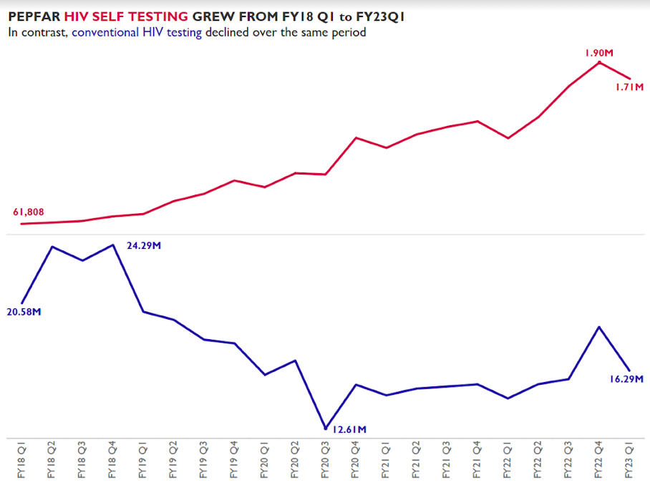
Considerations for HIV Self Testing
MER targets for HTS_SELF were limited in FY18
HTS_SELF targets and distribution has continued to increase each year
PEPFAR has distributed a total of 16,556,541 self test kits since FY18 (as of FY23Q1)
Notes:
I have about 4 more slides to present, and I wanted to take this time include some considerations for HIVST as the landscape for testing is rapidly expanding to include this testing option.
As we see here, PEPFAR has scaled up the distribution of HIVST from 2018 to 2023; since 2018, PEPFAR has distributed over 16.5 million self test kits.

Slide 14
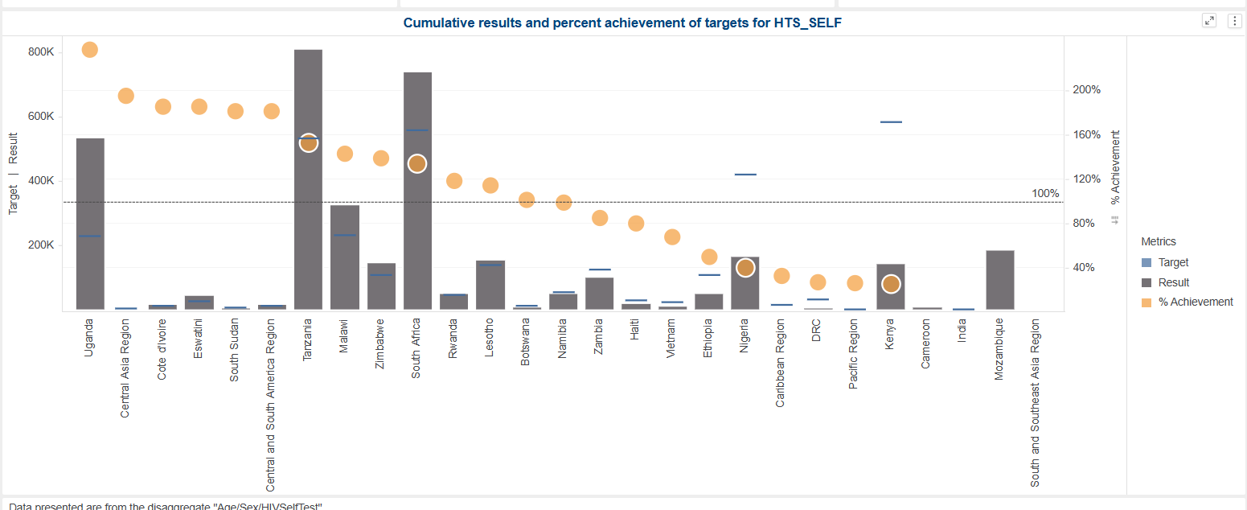
CDC Supported Countries Continue to Scale up HIVST
In FY23
Malawi, Uganda Tanzania, South Africa distributed
400K+
HIVST Kits
distributed
Notes:
And this large scale up is evident across the majority of PEPFAR supported programs. Malawi, Uganda, Tanzania, and South Africa each distributing more than 400K self test kits in FY23 among CDC supported PEPFAR sites. 2023 distributions surpassing that of 2022, with similar trends projected for this fiscal year as well.

Slide 15
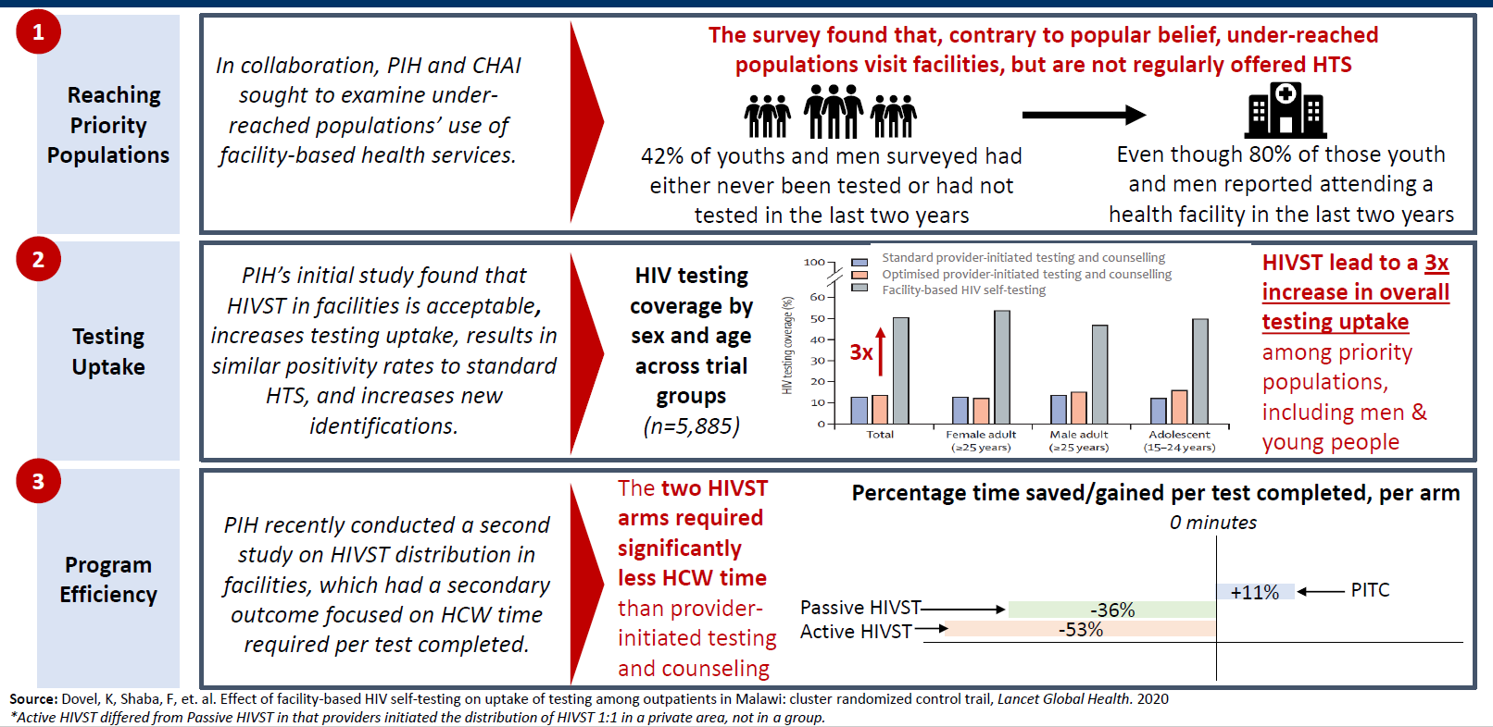
HIVST in facilities can improve coverage, close gaps, and address human resource limitations
Notes:
Studies that have shown how HIVST can be used to reach priority populations, a study in Malawi showed that HIVST led to a 3x increase in testing coverage among priority population. In addition, a subsequent study showed how HIVST significantly reduced health care workers time required per test completed as compared to the standard of PITC,

Slide 16
Considerations for HIV Self Testing
HIVST is a tool in our HTS toolbox
provide options to clients
help mobilize people to get tested
screening tools, especially in certain high-risk populations
Quality measures can still be taken
Adhere to appropriate storage conditions
  More heat sensitive than some RTKs
Inclusion in post market surveillance
Include in national training curriculum
Ensure use of strong instructions for user
Notes:
Thus, HIVST is an additional components to testing and testing services.
HIVST is a tool in our testing toolbox. It provides options to the client on how they want to manage their care, allowing for self-managed care, it can serve as a screening tool utilized specially in certain high-risk population, it can help to mobilize people to get testing and enter the HIV services continuum. The data shown, along with the WHO recommendation, emphasizes the need to recognize the fact that HIVST has evolved from being a mobilization tool to a tool that can further optimize existing HIV testing approaches and strengthen efficiencies in service delivery.
In terms of quality measures, although we can not apply all aspect that we will be discussing this week regarding RTCQI, things that can and should be consider when looking at quality for self test kits include:
-adherence to appropriate storage conditions as some kits are a bit more heat sensitive than most rapid test kits, by ~10 degrees.
-making sure self test kits are included in post-market surveillance, though this is not a strict guidance, this is one way, however, to look at quality if this is a concern, and all though post market surveillance this it is not formally include in RTCQI, it is one way it can take a small steps towards quality measures.
-making sure that it is included in national guidelines, as well as including HIVST in national training curriculum for HIV testing services for testers.
- And lastly, ensuring that the instructions on how to use the kits are country specific, and are proven to work in the country, as well as having a variety of instructions material- that is videos, paper based, hotlines.

Slide 17
Closing Thoughts & Considerations
Positive predictive value of HIV-positive diagnosis is quite high using serial RT-based algorithm (>99.2%-99.4%)
Extensive training, provider & site certification and ongoing monitoring and corrective actions are critical for accurate HIV testing
Including HTS quality indicator through site level managements (Granular Site Mgmnt, SIMS) as a standardize quality assurance approach can be a measure of performance against quality standards and way to identify areas in need of improvement
Retest for verification is a quality control measure essential to RT CQI, regardless of your diagnostic algorithm
Providers should be reminded that retesting PLHIV on ART may lead to a false-negative result
All efforts should be made to achieve 100% accuracy for correct test results
HIVST reduces barriers to testing, promotes self-managed care, can simplify and streaming HIV testing in facilities.
Consider efforts to include HIVST into aspects of Quality Management systems
Notes:
In summary,
We know that using a verified and validated rapid test-based algorithm can produce high positive predictive value of HIV positive diagnoses, and thus a way to ensure quality, however we know this still leaves a non-significant number of false-positives.
Conducting extensive training, provider & site certification and ongoing monitoring and corrective actions are critical for accurate HIV testing.
Including HTS quality indicator through site level managements (GSM, SIMS) as a standardize quality assurance approach can be a measure of performance against quality standards and way to identify areas in need of improvement
Retest for verification is a quality control measure essential to RT CQI, and important regardless of your diagnostic algorithm
It is important that providers be reminded that retesting PLHIV on ART may lead to a false-negative result
All efforts should be made to achieve 100% accuracy for correct test results
HIVST reduces barriers to testing, promotes self-managed care, can simplify and streaming HIV testing in facilities.

Slide 18
Discussion Questions
Discussion questions:
  How are we supporting MOH to come to develop these algorithms and changes? How can we (as CDC country teams and CDC HQ iSMEs better support the process)
  How do your national HIV testing programs work to ensure quality, and what leadership role does the MOH play?
Notes:
Here are some final questions for you all that we can get to in our discussion through out the week are:
How are we supporting MOH to come to develop these algorithms and changes? How can we (as CDC country teams and CDC HQ iSMEs better support the process)
How do your national HIV testing programs work to ensure quality, and what leadership role does the MOH play?

Slide 19
Thank you!

Slide 20
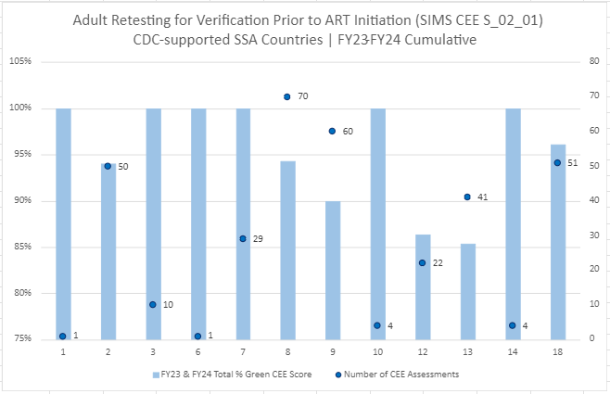
  Do the national HIV Testing Services (HTS) or ART guidelines include retesting for verification prior to or at ART initiation?
  Is a standardized process available for conducting and documenting retesting for verification prior to or at ART initiation?
  What %of adult & adolescent client records reviewed have documentation that retesting for verification occurred before ART initiation?
Data Source: CDC Strategic Data Management System (sDMS) Power BI Dashboard
Notes:
As a reminder assessments of these CEEs are not a requirement but a recommendation based on the programs needs, therefore the number of assessments completed will vary for each country. These data are show with the dark blue markers, while the blue bars represent the percent of sites assessed for this CEE that had a green score. Out of the 18 CDC supported African programs, 11 included this CEE in their assessments between FY23-FY24. And out of the 1075 total assessments performed by these programs in this time frame, 343, or 32%, assessed this CEE. The majority of sites where this indicator was assessed appear to be compliant with the retesting for verification standards.
Do the national HIV Testing Services (HTS) or ART guidelines include retesting for verification prior to or at ART initiation?
Is a standardized process available for conducting and documenting retesting for verification prior to or at ART initiation?
What %of adult & adolescent client records reviewed have documentation that retesting for verification occurred before ART initiation?

Slide 21
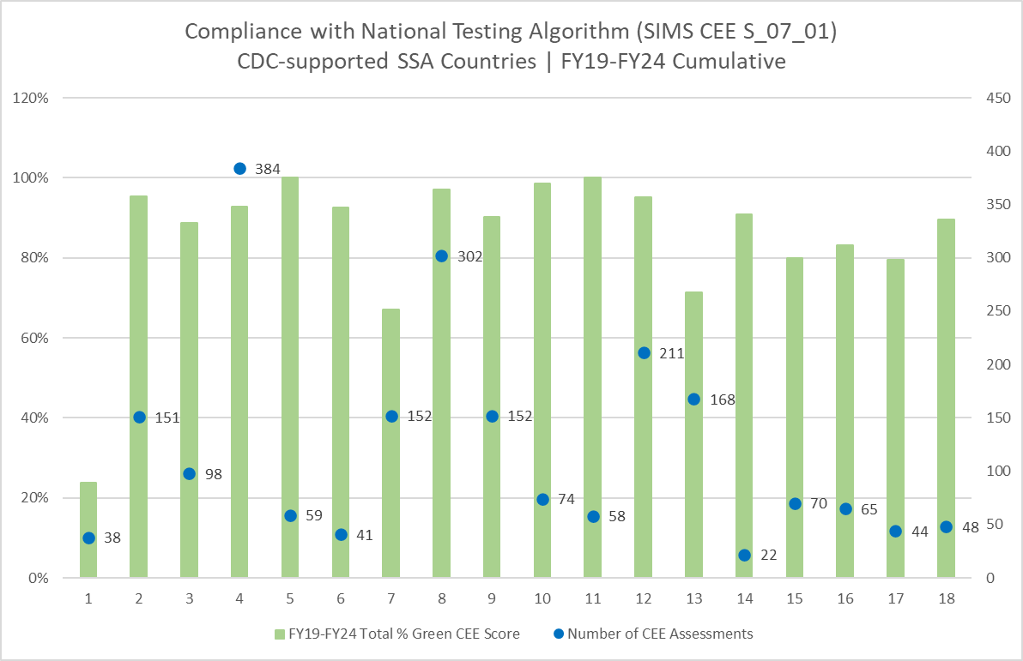
  Testing protocols or other job aides that are in full accordance with the current national testing algorithm available at site?
  Is the site collecting test results and final test results in either an HTS register, rapid testing logbook or some other data collection tool?
  What percentage of the 20 most recent entries within the past 12 months are compliant with the national testing algorithm?
Data Source: CDC Strategic Data Management System (sDMS) Power BI Dashboard
Notes:
A deeper dive into the next CEE, compliance with the national testing algorithm amongst CDC-supported African programs shows to be assessed more frequently with some variability in the number of sites assessed for the CEE to score green. Compliance includes the use of job aides & protocols that are in accordance with the current algorithm, use of a register that documents HTS data including RTK lot and result, as well as correct reporting/documentation of HIV positives. Out of the 3154 assessments by CDC supported African programs, 2137, or 68% included this CEE. We see here some more variability but a higher proportion of assessments performed on this CEE.
Testing protocols or other job aides that are in full accordance with the current national testing algorithm available at site?
Is the site collecting test results and final test results in either an HTS register, rapid testing logbook or some other data collection tool?
What percentage of the 20 most recent entries within the past 12 months are compliant with the national testing algorithm?

Slide 22
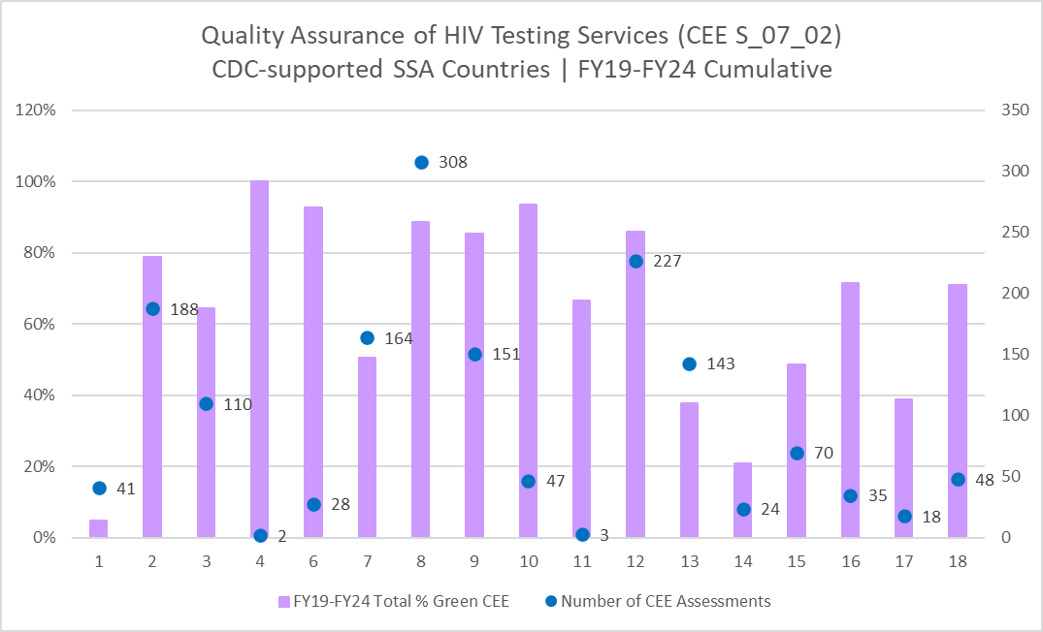
  Does the manager or laboratorian observe and document each HTS provider conducting HIV rapid testing at least twice a year?
  Does the manager or laboratorian at the HTS site review the logbook/HTS register at least monthly for evidence of compliance with national testing algorithm?
  In the HTS register/logbook, is there a process in place to review QA variables at least quarterly?
Data Source: CDC Strategic Data Management System (sDMS) Power BI Dashboard
Notes:
The final CEE assesses the implementation of QA of HIV testing services at a site. Here we see the greatest variability with high frequency of assessments. This CEE assesses that QA procedures including direct observation, & the use and verification of standardized log books are implemented with fidelity at a site. Similar to the previous CEE, there is variability in percent scoring green, with about 50% of total assessments by CDC supported African programs including this CEE.
Does the manager or laboratorian observe and document each HTS provider conducting HIV rapid testing at least twice a year?
Does the manager or laboratorian at the HTS site review the logbook/HTS register at least monthly for evidence of compliance with national testing algorithm?
In the HTS register/logbook, is there a process in place to review QA variables at least quarterly?

